Slide 1
Group10 : Feng Ruhui / Zhao Jinghao
TLS Handshake Process
Complete Demonstration
Cryptography Implementation and Analysis Based on Java
Java Implementation
Security Analysis
7-Stage Protocol
Course
Date
SC6104 Introduction to Cryptography
February 2026

Slide 2
Introduction
Project Overview
Project Objectives
Core Demonstration Modules
Complete simulation of 7 key stages of TLS handshake through Java code, providing an educational platform for understanding modern cryptographic protocols.
1
RSA Key Exchange
Asymmetric encryption for secure Pre-Master Secret transmission
Demonstration Value
2
Certificate Verification
CA signature validation to prevent MITM attacks
Visualize TLS handshake process with step-by-step execution
Deep understanding of asymmetric and symmetric cryptography
3
AES-GCM Cipher Suite
Showcase practical applications in real-world secure communications
Authenticated encryption for secure data transmission
4
Complete Handshake
Full TLS handshake simulation integrating all modules
Presentation Duration
4
Modules
Approximately 6 minutes with live demonstrations

Slide 3
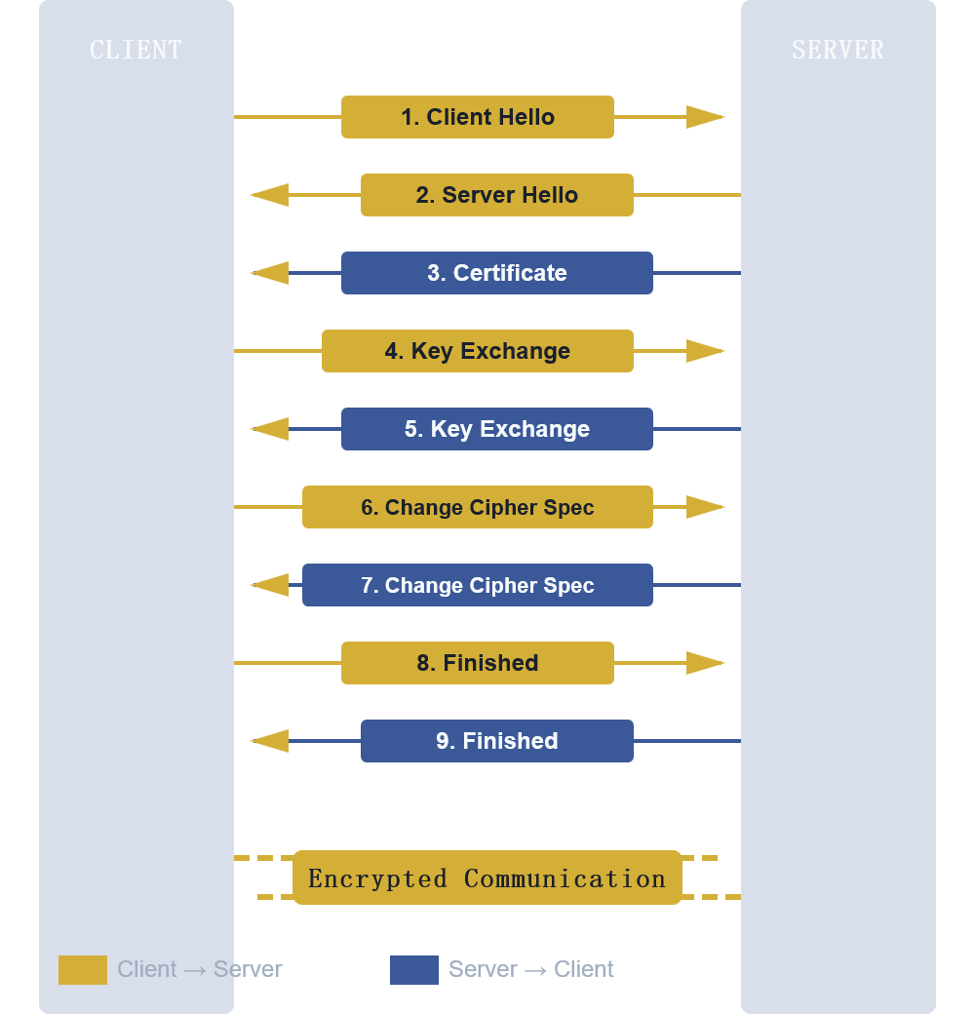
Protocol Flow
TLS Handshake 7-Stage Overview
Complete Handshake Sequence
1
Negotiation Phase
Client/Server Hello: Algorithm negotiation, random number exchange (R1, R2)
2
Identity Verification
Server presents X.509 certificate with CA signature for authentication
3
Key Exchange
Pre-Master Secret (PMS) encrypted with server public key, transmitted securely
4
Session Key Generation
Both parties derive identical session key from R1, R2, PMS using PRF
5
Encrypted Communication
AES-GCM symmetric encryption for all subsequent data transmission
Key Insight: Asymmetric encryption secures key exchange; symmetric encryption ensures efficient data transmission

Slide 4
Core Module 1
RSA Key Exchange
Mathematical Principles
Demonstration Flow
Encryption Formula
1
Server Generates RSA Key Pair
C ≡ PMSe (mod n)
2048-bit RSA key pair generation
Decryption Formula
KeyPairGenerator.getInstance("RSA")
PMS ≡ Cd (mod n)
2
Client Generates PMS
Security: Only server with private key d can decrypt PMS
48-byte random number: TLS version (2 bytes) + random data (46 bytes)
3
Client Encrypts PMS
Key Security Points
Encrypt using server public key → Output: Ciphertext (Base64)
Asymmetric encryption secures symmetric key exchange
4
Server Decrypts PMS
Only server can decrypt PMS, ensuring confidentiality
Decrypt using private key → Verify: PMS matches original
5
Generate Session Key
Both parties compute:
Session Key = SHA-256(R1 || R2 || PMS)

Slide 5
Core Module 2
Digital Certificate & CA Signature
Core Mechanisms
Verification Flow
CA Signature Process
1
CA Generates Key Pair
Sign = RSA_Encrypt(SHA-256(Cert), CA_Priv)
RSA 2048-bit key pair: CA private key (secret) for signing, CA public key (public) for verification
Client Verification
Verify(Sign, Hash(Cert), CA_Pub)
2
CA Signs Certificate
• Compute certificate hash (SHA-256)
MITM Attack Prevention
• Sign hash with CA private key
• Output: Digital signature (Base64)
Valid CA Signature
Verification passes ✓
3
Client Verifies Signature
Attacker Forged Signature
• Recompute certificate hash
Verification fails ✗
• Verify using CA public key
✓ Server identity verified
Tampered Certificate
Hash mismatch detected ✗
Security: Attackers cannot forge CA signature without CA private key; certificate tampering is detected via hash verification

Slide 6
Core Module 3
AES-GCM Symmetric Encryption
Algorithm Characteristics
Encryption & Decryption Flow
Algorithm
AES-256-GCM
1
Derive AES Key from Session Key
Extract 32 bytes from session key as AES-256 key
Mode
Galois/Counter Mode
2
Client Encrypts HTTP Message
Key Advantage:
• Input: HTTP request (plaintext)
Authenticated Encryption with Associated Data (AEAD) — provides both confidentiality and integrity
• Generate random IV (12 bytes)
• AES-GCM encryption
• Output: Ciphertext + IV (Base64)
Key Security Points
3
Server Decrypts HTTP Message
Symmetric encryption is much faster than asymmetric
• Input: Ciphertext + IV
GCM mode provides encryption + authentication
• AES-GCM decryption
Unique IV per encryption: same plaintext → different ciphertext
• Output: Original HTTP message
4
Tampering Detection Demo
• Scenario: Modify 1 byte in ciphertext
✗ Decryption fails, exception thrown
• GCM mode automatically verifies data integrity

Slide 7
Integration
Complete TLS Handshake Flow
1
Client Hello & Server Hello
5
Session Key Generation
• Negotiate TLS version and cipher suite
• Generate session key using R1, R2, PMS
• Exchange random numbers R1 and R2
• Output: Session key (Base64)
• Output: Negotiation results, random numbers (Base64)
6
Change Cipher Spec & Finished
2
Server Certificate
• Both parties switch to encrypted mode
• Server presents certificate information
• Exchange Finished messages to confirm handshake completion
• Display: Subject, Issuer, validity period, etc.
7
Encrypted Communication
3
Certificate Verification
• Encrypt HTTP messages using session key
• Client verifies certificate authenticity
• Server decrypts HTTP messages
• CA signature validation process
✓ Data transmitted completely and securely
✓ Certificate verification passed
Execution Command
4
Key Exchange
java tls.demo.TLSHandshakeSimulator
• Client generates PMS
• Encrypt PMS with server public key
• Server decrypts PMS with private key
✓ PMS match successful
Key Takeaways
Asymmetric encryption (RSA) securely exchanges symmetric keys
Symmetric encryption (AES-GCM) efficiently encrypts actual data
Digital certificates and CA signatures prevent MITM attacks
Session keys generated from both random numbers and PMS ensure uniqueness

Slide 8
Security Assessment
Security Analysis & Protection
Key Exchange Security
Identity Verification
Data Encryption Security
RSA Foundation:
CA Signature:
AES-256 Strength:
Security based on large integer factorization problem — computationally infeasible to derive private key from public key
Prevents certificate forgery — attackers cannot create valid signatures without CA private key
256-bit key provides computational security — brute force attack infeasible
Tamper Detection:
GCM Authentication:
Exclusive Decryption:
Any modification to certificate changes hash value, causing verification failure
Provides both confidentiality and integrity — any tampering detected immediately
Only server with private key d can decrypt PMS
Eavesdropping Protection:
MITM Prevention:
Replay Attack Prevention:
Even if attacker intercepts ciphertext, PMS cannot be recovered without private key
Attackers cannot impersonate legitimate servers without valid CA-signed certificate
Unique IV for each encryption ensures same plaintext produces different ciphertext
Limitations
Extended Topics
⚠
This project demonstrates RSA key exchange (TLS 1.2 method)
TLS 1.3 Improvements: 0-RTT handshake, faster speed, enhanced security
⚠
TLS 1.3 has removed RSA key exchange, replaced with ECDHE
Forward Secrecy: Even if server private key leaked, historical communications remain secure
⚠
ECDHE provides forward secrecy — compromised server key doesn't expose past sessions

Slide 9
Implementation
Technical Implementation
Implementation Stack
Code Structure
Programming Language
KeyExchangeDemo.java
Java 8+
RSA key exchange demonstration
java tls.demo.KeyExchangeDemo
Cryptography Library
Java Cryptography Extension (JCE)
SignatureVerify.java
CA signature verification
Core Algorithms
java tls.demo.SignatureVerify
Asymmetric Encryption
RSA 2048-bit
CipherSuite.java
AES-GCM symmetric encryption
Symmetric Encryption
AES-256-GCM
java tls.demo.CipherSuite
Hash Algorithm
SHA-256
TLSHandshakeSimulator.java
Complete handshake integration
Signature Algorithm
SHA256withRSA
java tls.demo.TLSHandshakeSimulator
Key Lengths
Design: Each module runs independently with detailed console output, mathematical formulas, and security analysis
RSA Key
Pre-Master Secret
AES Key
Client/Server Random
2048 bits
48 bytes
256 bits
32 bytes each

Slide 10

Conclusion
Project Summary & Future
Core Achievements
Learning Outcomes
Future Directions
Complete implementation of 7 TLS handshake stages
Understanding asymmetric-symmetric encryption coordination
1
Implement TLS 1.3 with ECDHE key exchange
2
Add forward secrecy demonstration
In-depth demonstration of core cryptography principles
Mastering digital certificate and CA signature mechanisms
3
Performance optimization and extended scenarios
Practical application showcase with real-world scenarios
Comprehending TLS security guarantee mechanisms
Thank You!

